Slide 1
TBM BORABILITY AS A FUNCTION OF ROCK MINERALOGY AND GEOTECHNICAL PROPERTIES IN SLBC TUNNEL OF AMR PROJECT, TELENGANA, INDIA D.Ramakrishna Assistant Professor, Dr.MGR.Educational Research Institute, Maduravoyal, Chennai-600095

Slide 2
1. INTRODUCTION:
The Srisailam Left Bank Canal Tunnel scheme (SLBC) of Alimineti Madhava Reddy Project (AMRP) aims to bring Krishna water from Mahaboobnagar District to the drought prone area of Nalgonda District,Telengana state. To meet this objective, construction of two tunnels of length 43.93 Km and 7.121 Km (see Fig.1), interconnected by Link Canal – 1, Dindi Balancing Reservoir and Link Canal – 2 is envisaged.

Slide 3
Tunnel-1 has a finished diameter of 9.2 m with a circular cross section and is being bored by two Tunnel boring machines (TBM) from Outlet and Inlet ends.
Tunnel – 2 has a horse shoe shape with diameter 8.758 m and was excavated by Drill Blast and Muck (DBM) method.
This scheme is executed by Irrigation and CAD Department by the Government of Telengana and formerly by Andhra Pradesh. The EPC contractor for this work is M/s Jaiprakash Associates Ltd.

Slide 4
2. SCOPE:
During construction of any long tunnel in hard rock by TBM, major problem faced is the wear of the cutter discs and its replacement and has significant implications on the project cost.
Engineering Geologist at site has to predict the Cutter life and explain when excess cutter consumption occurs.
Wear of the disc cutters is quantified by Cutter life index (CLI) which is the number of disc cutters required to bore unit length of tunnel or Cutter life which is the cubic meters of rock which can be excavated by one cutter disc.
Other factors governing TBM excavability are
rock mass characteristics
strength of the rock
machine parameters like design of cutterhead.
In this paper, a simple method of determining the Cutter life of TBM from petrographic test and geotechnical data which was carried out for Tunnel-1 is discussed.

Slide 5
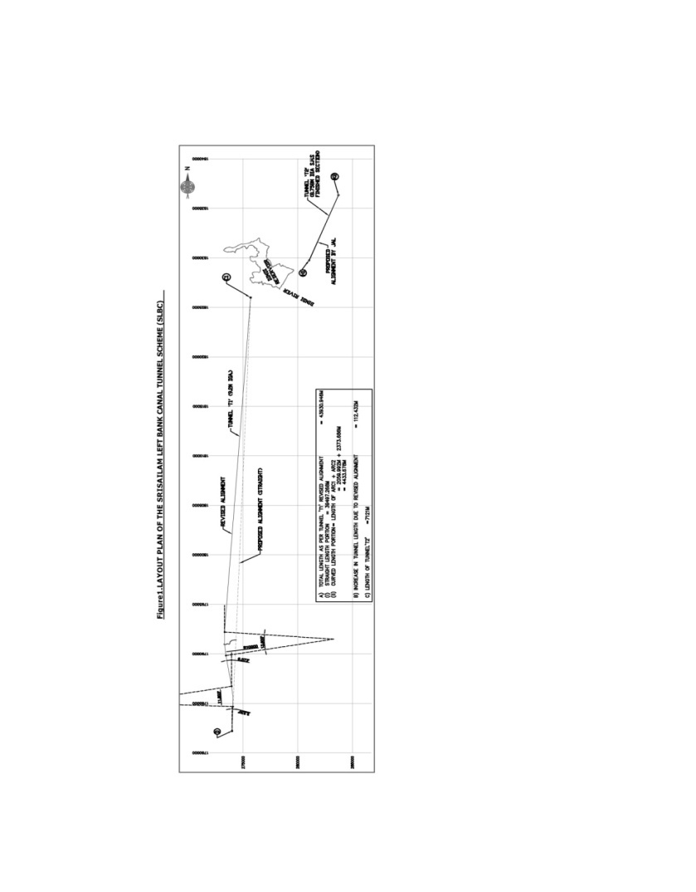
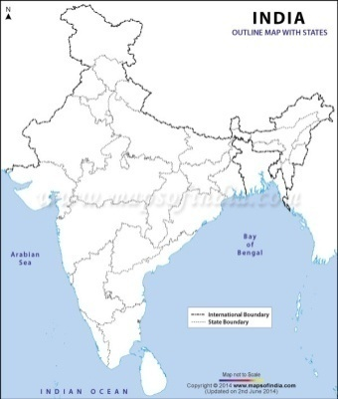
Fig.1. Location Map of AMRP Tunnel1 and Layout Plan of Project

Slide 6
4. Geology:
Geologically this area falls under the Peninsular gneissic complex of the Archeans from the Outlet end located in Mannevaripally Village,Chandampeta Mandal,Nalgonda District,Telengana
Srisailam formation comprising of meta sedimentary rocks of the Cuddapah super group from Inlet end.
The Archean rocks comprise of granites and granite gneisses with basic intrusives of mainly dolerites while the meta sedimentary rocks comprise of quartzites with shale interbeds and siltstones.
The contact of metasedimentaries with the archean gneisses is an unconformity.

Slide 7
5. Materials and Methods:
During construction stage of the project, systematic sampling was done in Tunnel1 till January 2014 and core/ lump samples were recovered.
Core sampling was done using HILTI DD130 core drilling machine and cores of NX size were recovered.
The samples were tested for mineralogy, physical and engineering properties.
Modal analysis of the rock sample was carried out by thin section petrography at Petrology Division, Geological Survey of India (GSI), Hyderabad and shown in Plates 1 and 2.

Slide 8
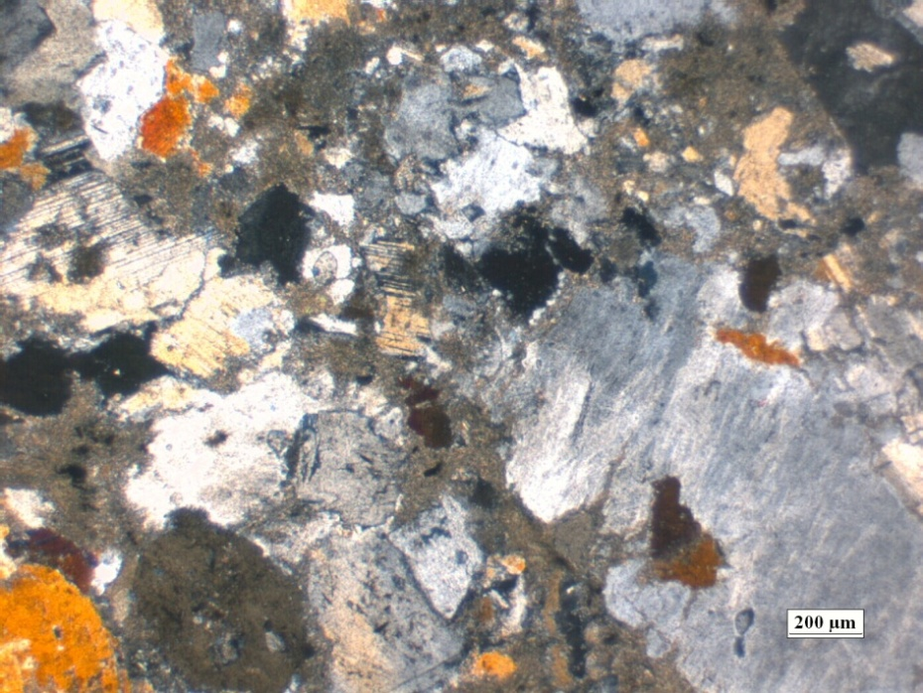
Petrographic Thin sections
Plate 1. Granite at CH.10 973M,Tunnel1,Outlet

Slide 9
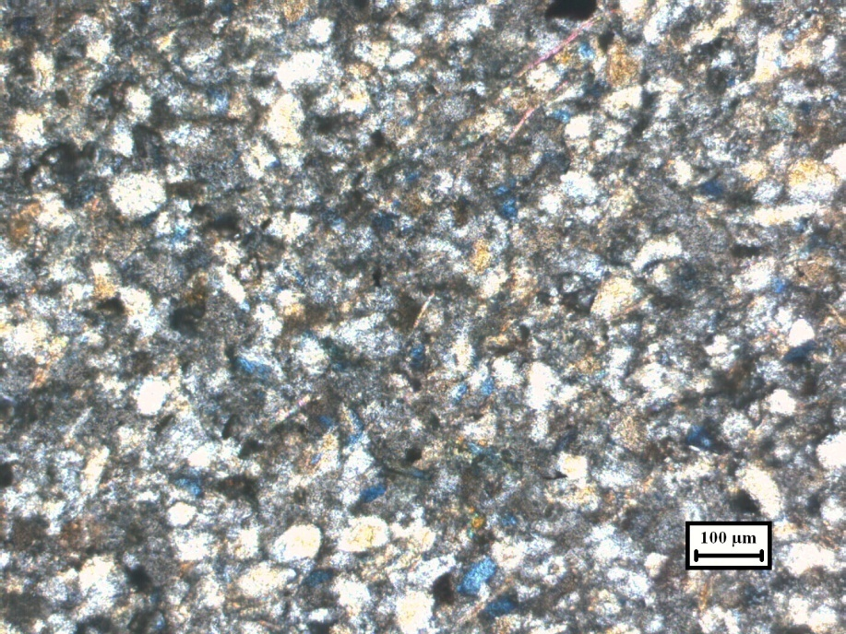
Petrographic Thin sections
Plate 2. Quartzite at CH.4570M,Tunnel1,Inlet

Slide 10
Table 1.Petrographic Test Reults

Slide 11
The Mean MOH’s hardness varies from 6.0 to 6.1 for Granite and 6.8 for quartzite.
Equivalent quartz content varies from 55.6 to 56.32 for granite and 96.1 for quartzite.
Table 2 gives the relationship between equivalent quartz content, Unconfined compressive strength (UCS), Rock Abrasive Index and cutter life (Cubic metres per disc).

Slide 12
Table 2. Rock Mineralogy, Unconfined Compressive strength(UCS), Rock Abrasivity Index(RAI)and Cutter Life in Tunnel-1

Slide 13
Rock Abrasive Index is estimated by multiplying the Unconfined compressive strength and equivalent quartz content (ISRM(2003)). Test numbers 3 and 4 show that rocks with nearly same RAI have different Cutter life depending on UCS
Fig.2 shows the variation of Cutter life (Cubic meters /disc) with Rock Abrasivity Index(RAI). It can be seen that Cutter life decreases non linearly( logarithmically) with increase in RAI.

Slide 14
Fig.2 Variation of Cutter Life with Rock Abrasivity Index(RAI) `

Slide 15
Fig.3. Variation of RAI with UCS

Slide 16
Discussion
It can be seen that Rock Abrasivity Index (RAI) increases as a polynomial function (second order) of UCS.
The influence of textural variation on cutter life is still not clear though it is expected that a rock with porphyritic texture may reduce the cutter life than a rock showing equigranular texture at the same UCS.

Slide 17
7. CONCLUSIONS:
Modal analysis of rock from thin section petrography provides a rapid and simple method of determining the Cutter life when UCS is known.
Rock Abrasivity index(RAI) varies as a polynomial function(second order) of UCS.
Cutter life(Cu.M/disc) decreases with increase in RAI as a nonlinear function.

Slide 18
References:
1. Balachandran, V (2006).Inspection note on Srisailam Left Bank Canal Tunnel Project,Andhra Pradesh. Unpublished Report, GSI
2. D.Ramakrishna and Anil A.Kamat (2008).Prognostication of Unconformity intersection at Tunnel grade for 43.93KM long tunnel by Geoelectrical survey.Jour.Engg.Geol. Vol.XXXV, Nos1-4,237-240.
3. Ramakrishna, D(2015).Geotechnical Properties of AMRP Tunnel-1 and Rock Borability by TBM.Special Publication, Journal of Engineering Geology October2015,431-439.
4. Thuro, K., and Plinninger, R.J. (2003) .Hard rock tunnel boring, cutting, drilling and blasting: rock parameters for excavatability ISRM (2003)-Technology road map for rock mechanics, South African Institute for Mining and Metallurgy.

